Slide 1
Demystifying budgets
JO DYER & SIMONE PARROTT

Slide 2
demystifying budgets
INTRODUCTION – Jo & Simone 5-minutes
Budget Fundamentals 30-minutes
Conversations 15-minutes
Q&A and FINAL WRAP UP 10-minutes

Slide 3
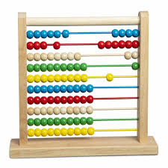
Models of producing
Self-produced
Sell-off/ buy in’s
Co-productions
Subsidised/ Government funded
Co-op / profit share

Slide 4

Talking confidently about money
Overcoming anxiety about money
What are your tour aims & Objectives (for profit, gain audiences for the work, provide employment)
Do the detail for all budgets
Know what your bottom line
ask insightful questions when structure a deal
...its ok to walk away if the deal is not right

Slide 5
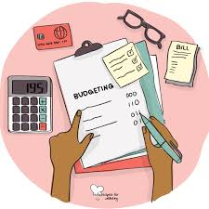
BUDGET MODELS
SELF-PRESENTING
CO-PRODUCING
Sell off/ buy in
Co-op/ profit share
Partly government funded
Projects can be scaled up and down depending on work

Slide 6
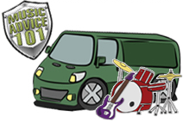
How to create a tour budget
Regardless of the tour aims and objectives the process of budgeting your tour should be:
- BASED ON QUOTES AND accurate REAL COSTS and
income projections
- be as detailed as possible including all
workings
- Include explanatory notes for decisions made

Slide 7

Tour income – SELF OR CO-PRODUCED
TOUR income can be generated from the following sources:
- ticket sales
- merchandise revenue (more for big shows)
- grant income
- philanthropic support/ donations
- Other sources – i.e.. Crowd funding

Slide 8
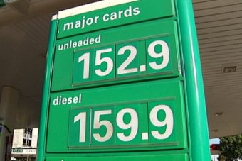
Tour expenses
TOUR expenses include but are not limited to:
- staffing costs – wages/ salaries, fees
- marketing & publicity – ads, design, distribution
- travel & accommodation – flights, accommodation, car hire,
fuel, per diems
- artist rider – backline, hospitality
- production & technical – staging, lighting, sound/av
- venue costs – venue, security, front of house, merch. seller
- insurance – public liability, worker’s compensation
- merchandise production

Slide 9

Tour break even
Depending upon your genre, tour size and market, your budget break even can vary.
- most producers work on a break even between 65%
& 70% on smaller tours
- on larger tours with greater demand, break even
may be as high as 80%
- break even higher than 85% is considered a very
high risk touring venture
brea

Slide 10
Structuring a budget
HEADER

Slide 11
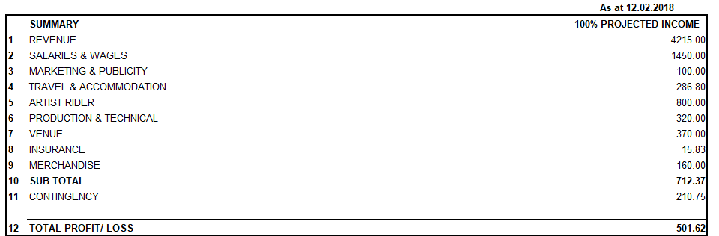
Structuring a budget
SUMMARY

Slide 12
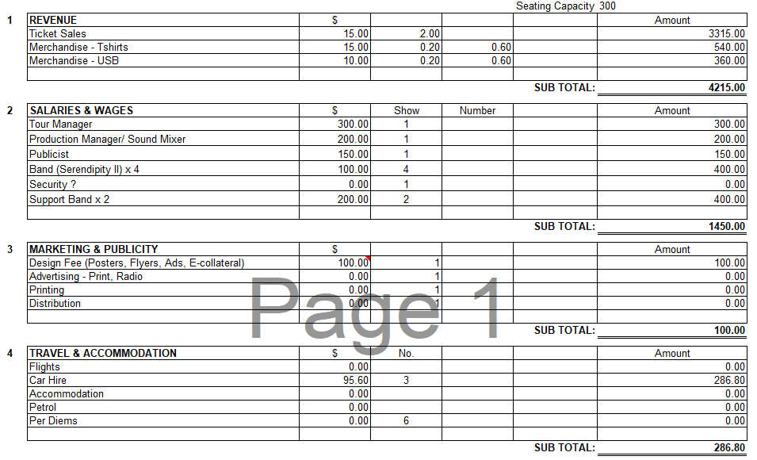
Structuring a budget
expenses

Slide 13
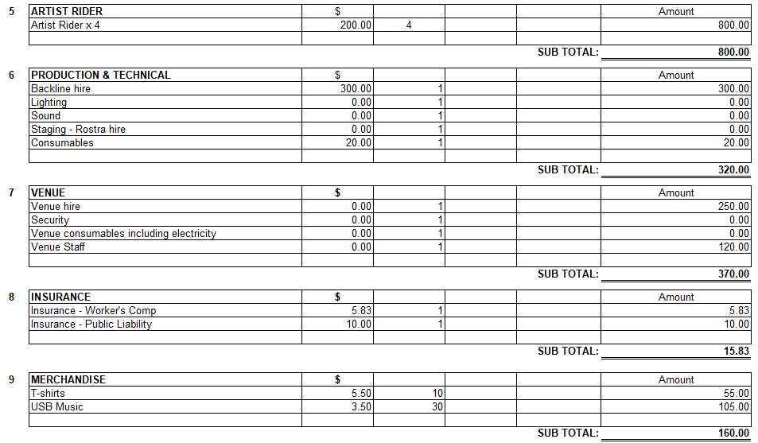
Structuring a budget
expenses

Slide 14
Structuring a budget
Sub total of expenses, contingency and profit/loss

Slide 15

Potential hazards of budgeting
- be realistic about project ticket sales and
income - ensure realistic ticket prices and
venue capacities
- never guess expenses – decisions will be made
regarding tour viability and this information
must be accurate.
- unrealistic sales and inaccurate expenses
usually result in high financial losses.

Slide 16

What is cASH FLOW?
Just as critical to your tours' financial position is your tour cash flow.
- cash flow is the total amount of money being
transferred into and out of a project, in this case
tour funds, affecting liquidity.
Having enough money to pay costs upfront (Such as venue rental, wages, hire charges, marketing and travel costs), before receiving income such as ticket sales and merchandise revenue is the greatest challenge for tour finances. how could you solve this critical financial issue?

Slide 17
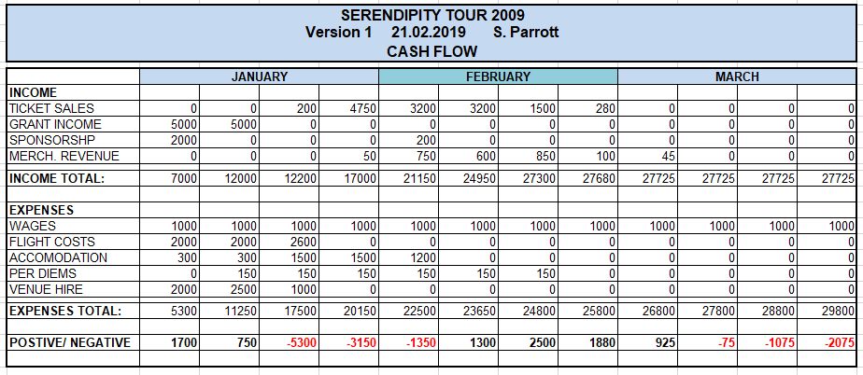
Sample tour cASH FLOW

Slide 18
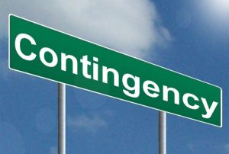
Grant funding in Australia
Creative Australia/ playing Australia
Create NSW (and all other state/ Territory bodies)
Local government / council grants
Foundations/ trusts/ corporate

Slide 19

GRANT FUNDING – ARTS ON TOUR
Arts on Tour apply for grants from two different funding bodies: Create NSW and Playing Australia. The Create NSW funding is for touring activity inside NSW, and Playing Australia is for anything outside of your home state (in this case NSW).
This funding has traditionally been for Net Touring Costs –
the day-to-day logistics of being on the road: accommodation, flights, cars, freight, and allowances.

Slide 20
GRANT FUNDING – ARTS ON TOUR
I say traditionally, because Playing Australia has now broadened their scope to cover any costs that make the tour viable. At Arts on Tour our focus is still mostly on travel costs, but we will sometimes ask for a small amount of the production costs if that helps make the tour more viable for presenters to buy.
There’s a $120k cap on Create NSW grants, but no limit to what you can ask for from Playing Australia.

Slide 21
GRANT FUNDING – ARTS ON TOUR
Both are highly competitive and have strict eligibility criteria, such as a minimum number of regional venues you need on the tour.
This can feel out of reach if you’re new to this – but certainly worth familiarizing yourself with now, so it isn’t so daunting next time.
The Playing Australia budget template is also great for detailed travel costing – we use a modified version of that at Arts on Tour for all our travel costings (this is available on the Tour Lab resources page!)

Slide 22
GRANT FUNDING – ARTS ON TOUR
Something that is much more accessible are local government grants, in particular quick response project grants. These are usually capped at $5k, and often run throughout the year, so these are a great way to flex your grant writing muscles. (And ask for feedback on your applications if they aren’t successful – we’re artists after all, we love getting notes, don’t we?!)

Slide 23
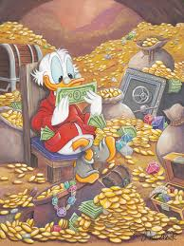
GRANT FUNDING – ARTS ON TOUR
I mentioned it in the opening, Arts on Tour also have a small grant program, Backroads, which has three grants up to $7k to tour to independent or community run venues. If you want to find out more about Backroads, chat to Mark.

Slide 24

CONVERSATIONS WITH ARTS ON TOUR
Tour financial objectives
Transparency - Understanding the difference between your internal budget and what you share with a potential partner or buyer?
Contingency – how do you manage ‘hidden’ revenue
royalties

Slide 25


